Slide 1
Collecting Newspaper Endorsements
Reference Slides
Prof. Kevin DeLuca
02/14/2025

Slide 2
Overview
Project description and purpose
Process
Finding Endorsements + Clippings
Recording Endorsements
Quality Assurance
Example: Los Angeles Times
Q&A
Bonus slides if time: chat GPT endorsement collector (in development)

Slide 3
Project Description and Purpose
An historical collection of local newspaper endorsements
Searching through newspaper archives, find clippings of endorsements made by local newspapers

Slide 4
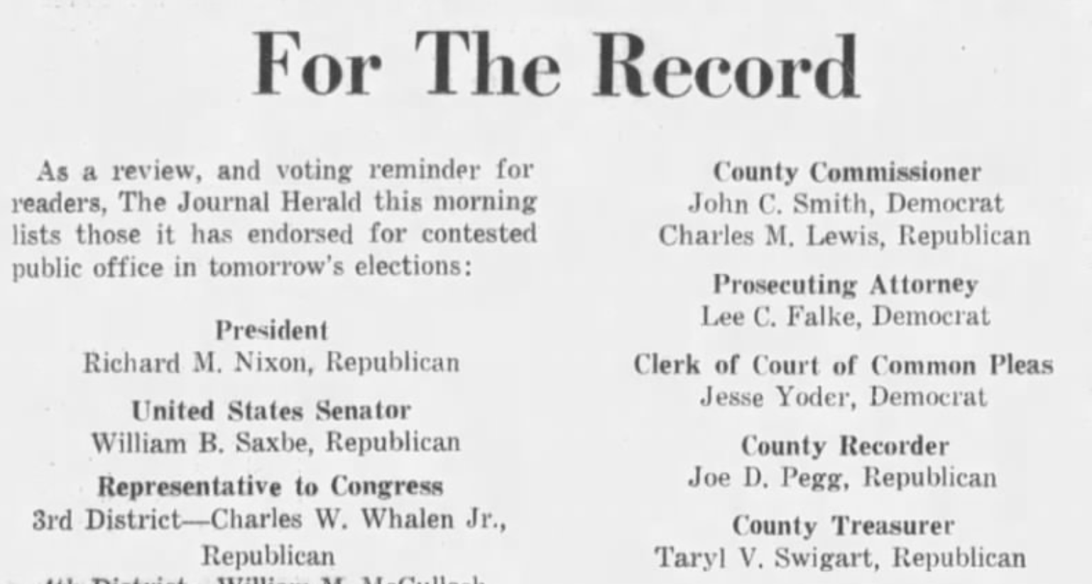
Project Description and Purpose
An historical collection of local newspaper endorsements
Searching through newspaper archives, find clippings of endorsements made by local newspapers
Dayton Journal Herald (Ohio), 1968 Endorsements

Slide 5
Project Description and Purpose
An historical collection of local newspaper endorsements
Searching through newspaper archives, find clippings of endorsements made by local newspapers
Is (was) a common practice in the US, and the US has (had) many newspapers – lots of data to collect

Slide 6
Project Description and Purpose
An historical collection of local newspaper endorsements
Searching through newspaper archives, find clippings of endorsements made by local newspapers
Is (was) a common practice in the US, and the US has (had) many newspapers – lots of data to collect
Useful for political science, economics, and social science research more broadly

Slide 7
Project Description and Purpose
An historical collection of local newspaper endorsements
Searching through newspaper archives, find clippings of endorsements made by local newspapers
Is (was) a common practice in the US, and the US has (had) many newspapers – lots of data to collect
Useful for political science, economics, and social science research more broadly
Currently, I have about ~60,000 candidate endorsements from hundreds of local newspapers, focused on 1960-2006 period
This is actually maybe only about 1/4th of endorsements out there, based on my estimates
Need to catalog and archive these endorsements, so others can use

Slide 8
Project Description and Purpose
What’s the point?
Endorsements contain two important bits of information
1. What is the partisan bias or preference of the newspaper (editors)?
Relative number of Dem vs Rep endorsements

Slide 9
Project Description and Purpose
What’s the point?
Endorsements contain two important bits of information
1. What is the partisan bias or preference of the newspaper (editors)?
Relative number of Dem vs Rep endorsements
2. Which candidates are “high quality”?
At a basic level, what candidates get endorsed more? (taking into account the partisan bias of the newspapers making endorsements)

Slide 10
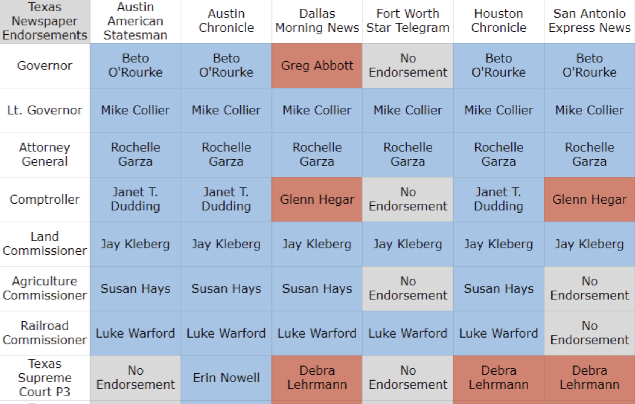
Example: Texas 2022 Endorsements

Slide 11
Project Description and Purpose
What’s the point?
Endorsements contain two important bits of information
1. What is the partisan bias or preference of the newspaper (editors)?
Relative number of Dem vs Rep endorsements
2. Which candidates are “high quality”?
At a basic level, what candidates get endorsed more? (taking into account the partisan bias of the newspapers making endorsements)
Measuring hard-to-measure stuff
Can construct measures of how partisan or biased newspapers are/were, to look at effect of media bias on elections, voter behavior, politics

Slide 12
Project Description and Purpose
What’s the point?
Endorsements contain two important bits of information
1. What is the partisan bias or preference of the newspaper (editors)?
Relative number of Dem vs Rep endorsements
2. Which candidates are “high quality”?
At a basic level, what candidates get endorsed more? (taking into account the partisan bias of the newspapers making endorsements)
Measuring hard-to-measure stuff
Can construct measures of how partisan or biased newspapers are/were, to look at effect of media bias on elections, voter behavior, politics
Can construct a measure of candidate quality, to better understand how much quality matters to voters (relative to partisanship), and how the importance of candidate quality has changed over time (as polarization increases)

Slide 13
Project Description and Purpose
What’s the point?
Endorsements contain two important bits of information
1. What is the partisan bias or preference of the newspaper (editors)?
Relative number of Dem vs Rep endorsements
2. Which candidates are “high quality”?
At a basic level, what candidates get endorsed more? (taking into account the partisan bias of the newspapers making endorsements)
Measuring hard-to-measure stuff
Can construct measures of how partisan or biased newspapers are/were, to look at effect of media bias on elections, voter behavior, politics
Can construct a measure of candidate quality, to better understand how much quality matters to voters (relative to partisanship), and how the importance of candidate quality has changed over time (as polarization increases)
In order to create these measures, need lots and lots of newspaper endorsements

Slide 14
Process – Collecting Endorsements
To collect endorsements and catalog them in the archive, we are following a detailed process
Need to find the clippings, in archives (online)
Need to record the endorsements, with specific variables
Need to log metadata about the paper and collection
Need to do “quality assurance”, to double check data
Need to upload to archive

Slide 15
Process – Collecting Endorsements
To collect endorsements and catalog them in the archive, we are following a detailed process
Need to find the clippings, in archives (online)
Need to record the endorsements, with specific variables
Need to log metadata about the paper and collection
Need to do “quality assurance”, to double check data
Need to upload to archive
Ultimately, you are going to create a folder for each newspaper, with all of the clippings saved and the endorsements recorded on spreadsheets
Time period: 1900ish-present
Data
Collection
“QA” Team

Slide 16
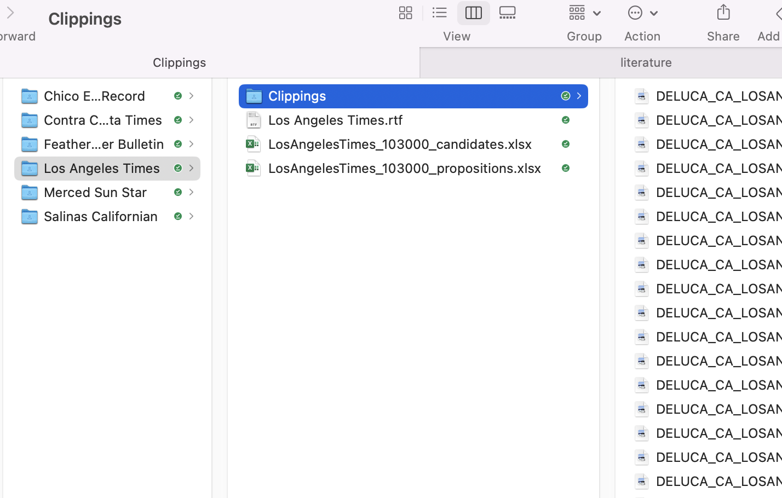
Process – Collecting Endorsements
You finished folder should look like this:
Clippings sub folder
Article clippings
Text/rtf metadata
Candidate spreadsheet
Propositions spreadsheet

Slide 17
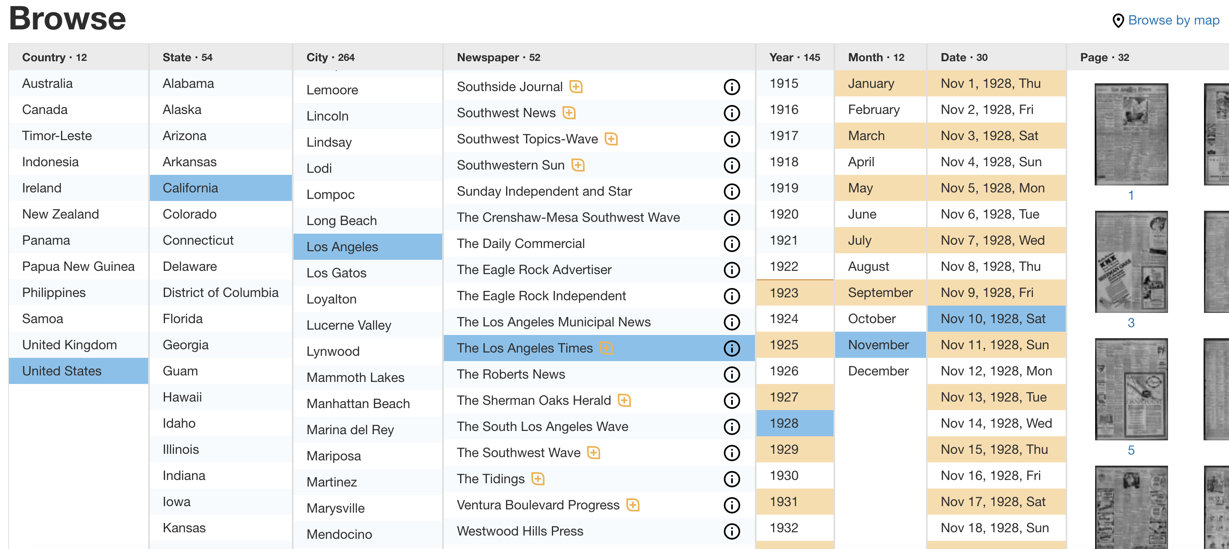
Process – Finding Endorsements
Mostly, we’ll be using newspapers.com, which is an online historical archive where you can view scanned images of newspapers

Slide 18
Process – Finding Endorsements
Steps for collecting endorsements
1. Find the paper, and go to election day on the year you’re trying to collect

Slide 19
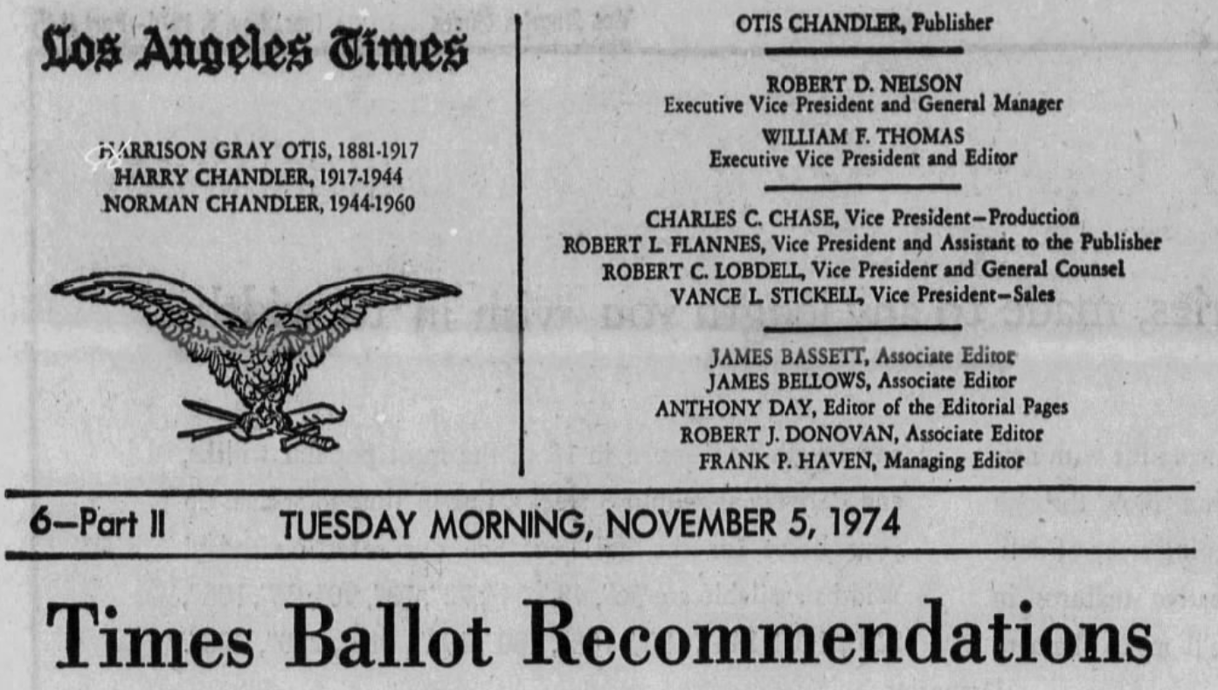
Process – Finding Endorsements
Steps for collecting endorsements
1. Find the paper, and go to election day on the year you’re trying to collect
2. Look for the editorial page: has the masthead and usually publisher and owner information:

Slide 20
Process – Finding Endorsements
Steps for collecting endorsements
1. Find the paper, and go to election day on the year you’re trying to collect
2. Look for the editorial page: has the masthead and usually publisher and owner information:
3. Look for endorsement lists or articles, and then create a “clipping” of the article to save to newspapers.com and in our archive
If you don’t find endorsements on election day, check the editorial page for up to 10 days before the election, looking for endorsement lists or articles
Not uncommon for endorsements to be run the day before or the Sunday before election day, rather than day-of

Slide 21
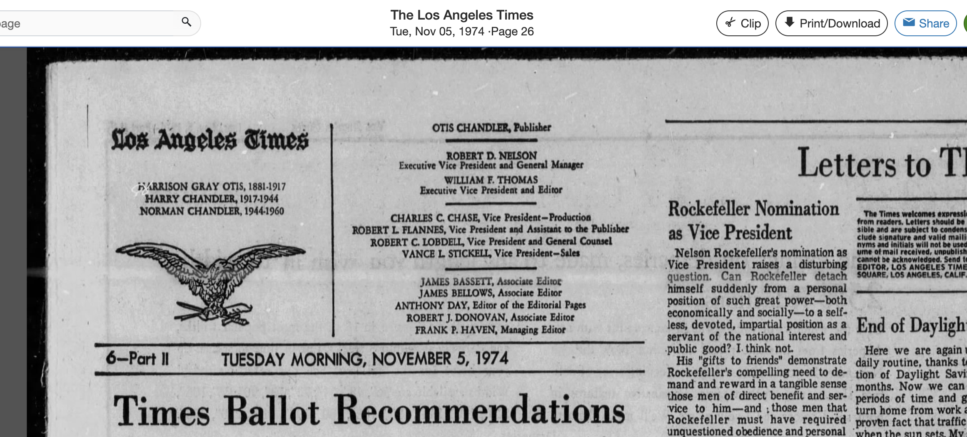
Process – Clipping Endorsements
When you find an endorsement, you need to “clip” it using newspapers.com – top right corner!

Slide 22
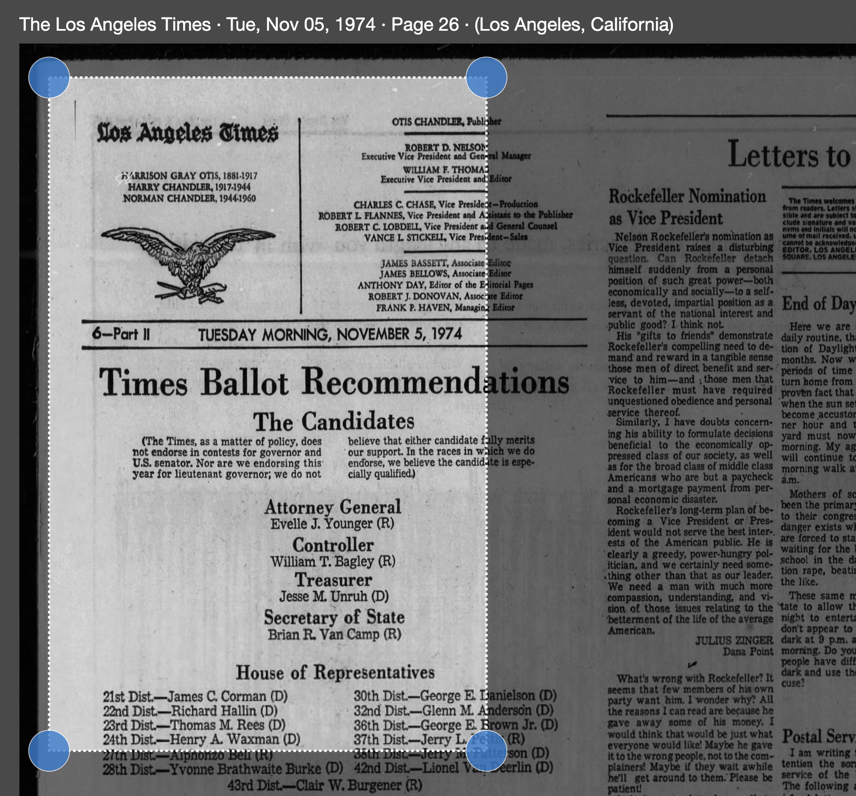
Process – Clipping Endorsements
Select the whole endorsement in the clipping (include masthead if possible), then save to account

Slide 23
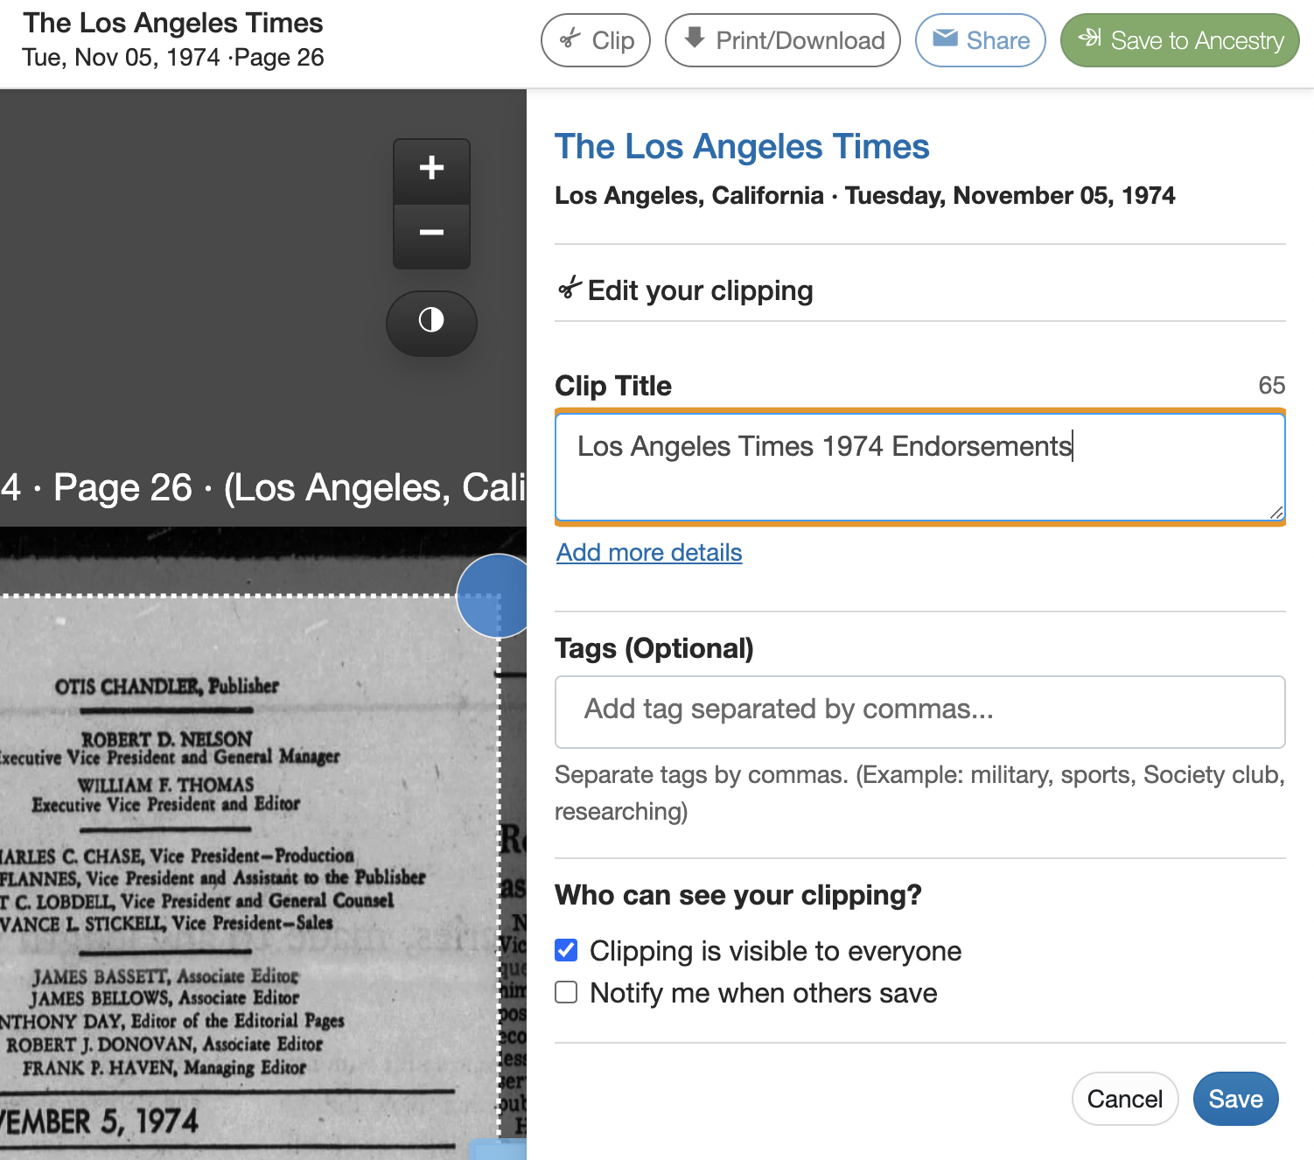
Process – Clipping Endorsements
Select the whole endorsement in the clipping (include masthead if possible), then save to account
Name the clipping something informative: I use “Newspaper Name Year Specific Endorsements”

Slide 24

Process – Clipping Endorsements
Select the whole endorsement in the clipping (include masthead if possible), then save to account
Name the clipping something informative: I use “Newspaper Name Year Specific Endorsements”
Last, download the PDF of the clipping, and save to newspaper “clipping” folder
See handbook for filenaming conventions

Slide 25
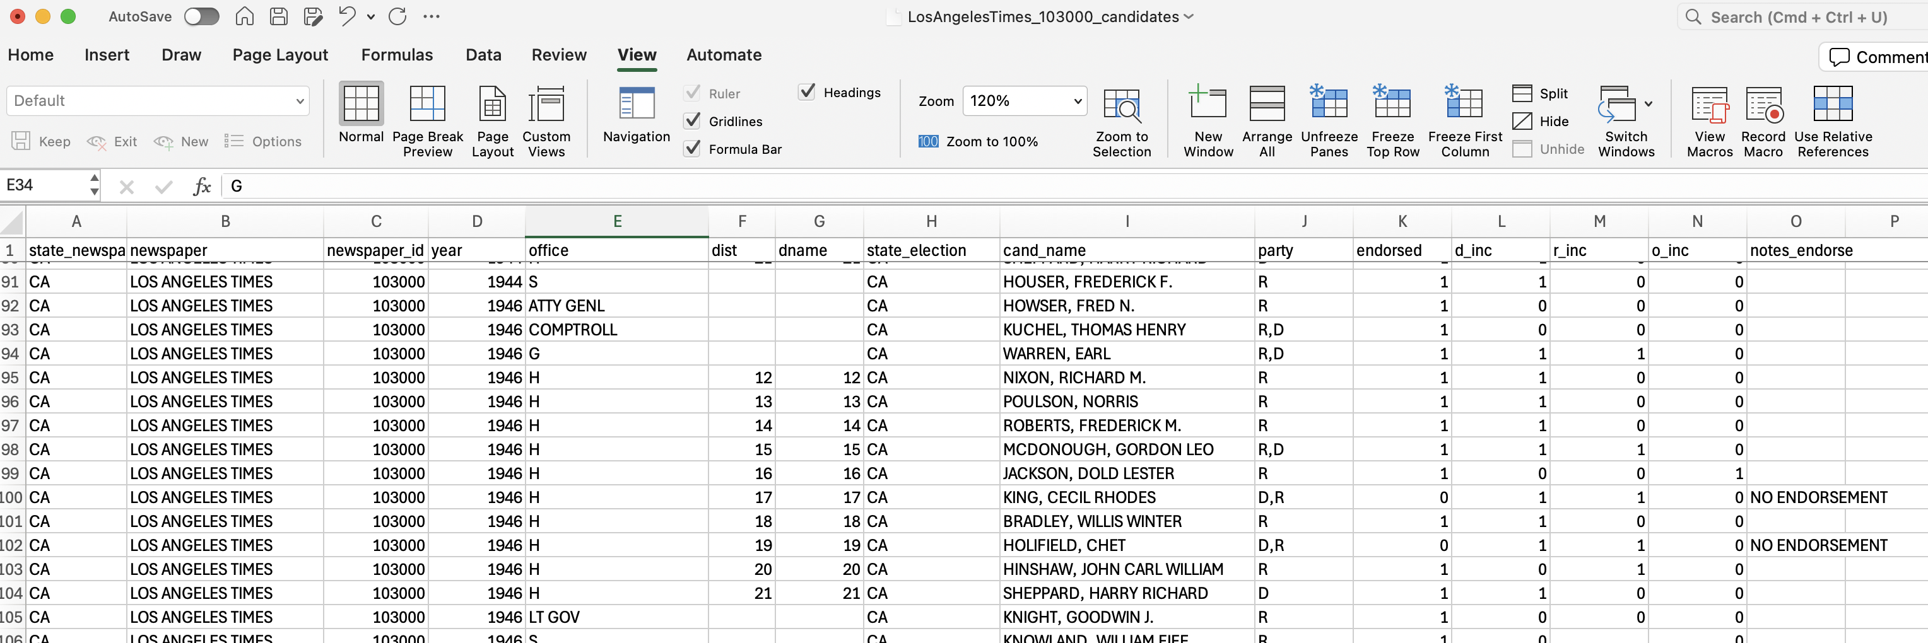
Process – Recording Endorsements
Once you have found endorsements, they need to be typed up
Candidate endorsements and propositions recorded separately
Handbook has all the specific variables that need to be recorded for each type of endorsement, and how they should be recorded

Slide 26
Process – Quality Assurance
After you have finished data collection, hand off your folder to the Quality Assurance (QA) Team

Slide 27
Process – Quality Assurance
After you have finished data collection, hand off your folder to the Quality Assurance (QA) Team
QA Team has instructions to double check over everything
If there are issues, like you forgot to type up a year of endorsements, or some of the variables are recorded incorrectly, then the QA Team will ‘send’ the folder back to you to fix
Once fixed, QA Team will re-check data
May go back and forth once or twice (or more), that’s sort of expected, so don’t feel bad if it happens – will get better as you get used to the process

Slide 28
Process – Quality Assurance
After you have finished data collection, hand off your folder to the Quality Assurance (QA) Team
QA Team has instructions to double check over everything
If there are issues, like you forgot to type up a year of endorsements, or some of the variables are recorded incorrectly, then the QA Team will ‘send’ the folder back to you to fix
Once fixed, QA Team will re-check data
May go back and forth once or twice (or more), that’s sort of expected, so don’t feel bad if it happens – will get better as you get used to the process
Once everything has been collected and QA-ed, the data is ready to upload to our online github archive

Slide 29
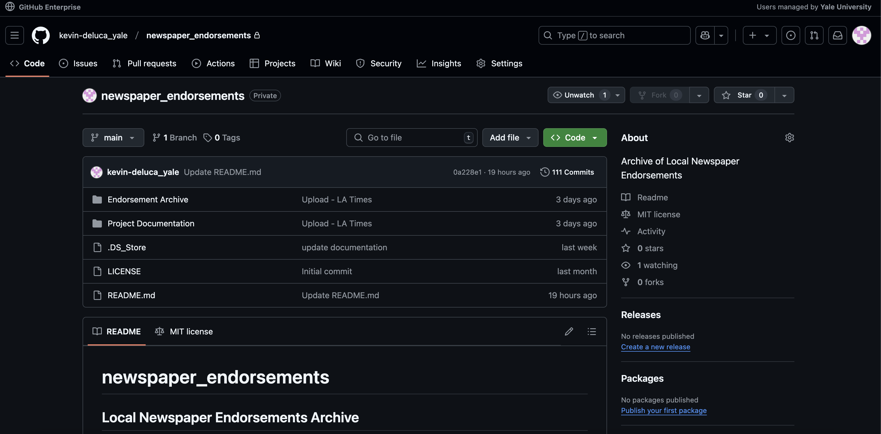
Process – Quality Assurance

Slide 30
Example: Los Angeles Times
Let’s find an endorsement page together
1920, 1932, 1974; on newspapers.com
Clipping and saving the endorsement
Recording the endorsement(s)
Updating the metadata
Using the handbook to help with all of this

